Slide 1





SALARY SURVEY ANALYSIS
PRESENTED BY : PARTHASARATHI A
BATCH : MAY
COURSE : DA-DS

Slide 2


AGENDA
OBJECTIVE OF THE PROJECT
DATA UNDERSTANDING
DATA CLEANING
EXPORT DATA TO MYSQL
PERFORMING QUERIES
KEY INSIGHTS
CONCLUSION

Slide 3



OBJECTIVE OF THE PROJECT
The objective of this project is to analyze global salary survey data to identify trends, patterns, and key insights across various factors such as job titles, industries, education levels, cities, countries, and gender.

Slide 4

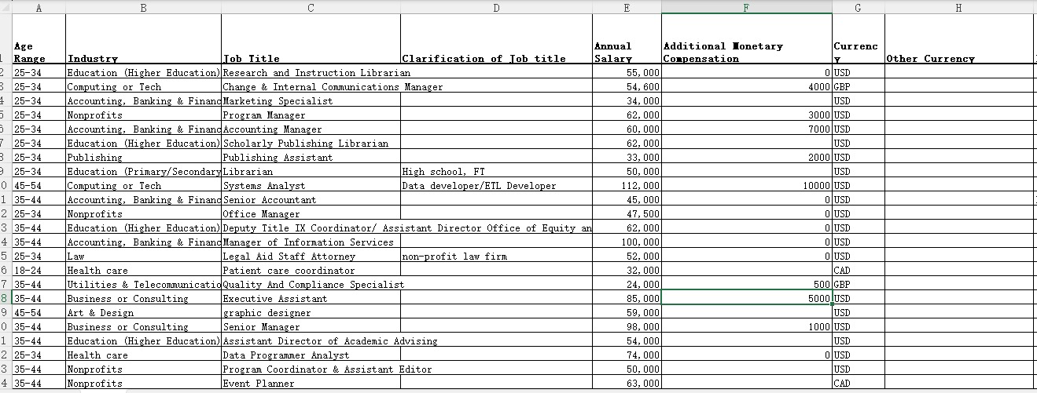
DATA UNDERSTANDING
28104 ROWS x 16 COLUMNS

Slide 5


DATA CLEANING
1.REMOVE DUPLICATES
2.FILL THE NULL VALUES
3.HANDLING OUTLIERS

Slide 6
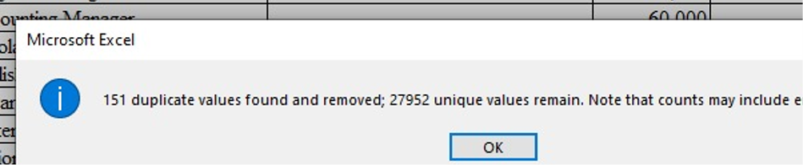
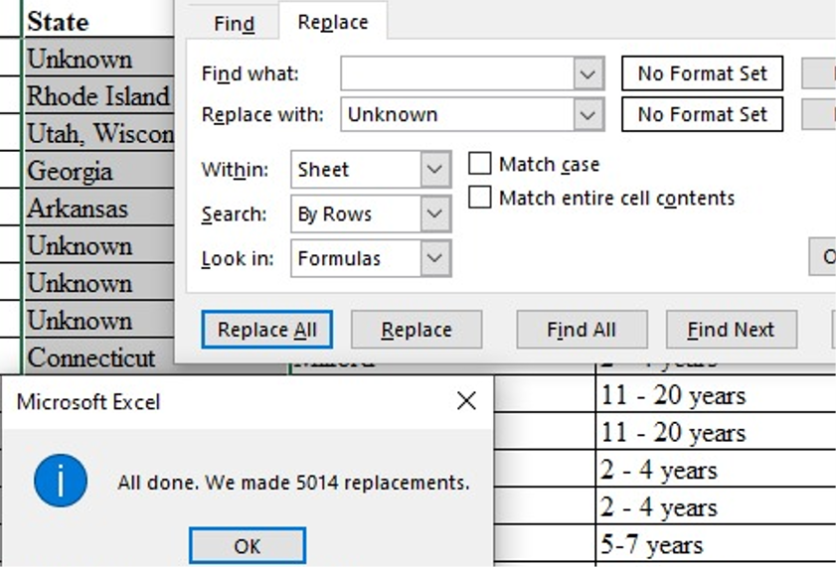
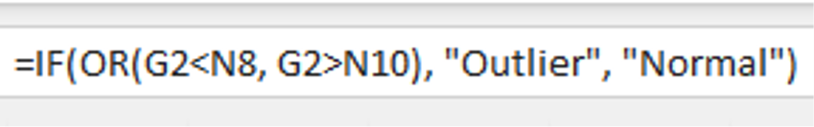

1.REMOVE DUPLICATES
2.FILL THE NULL VALUES
3.HANDLING OUTLIERS

Slide 7
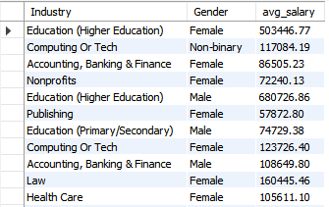
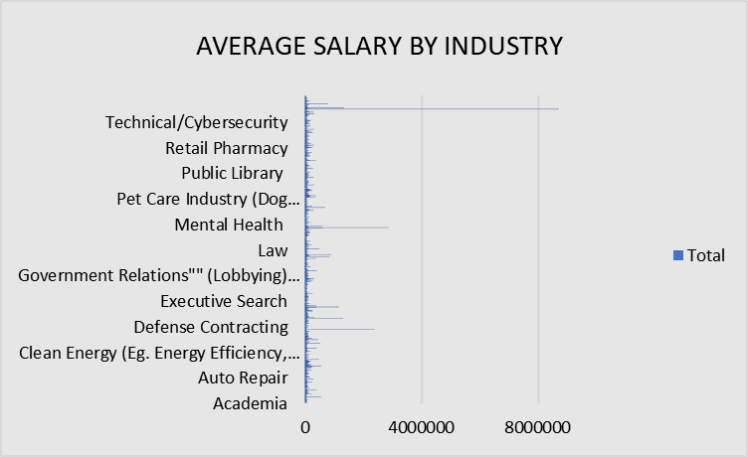
PERFORMING QUERIES
SELECT Industry, Gender, ROUND(AVG(annual_salary),2) AS avg_salary FROM salarysurvey GROUP BY Industry, Gender;

Slide 8

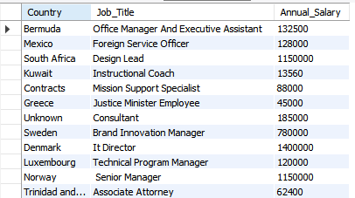
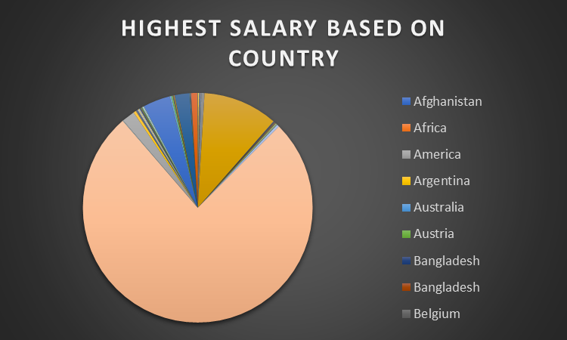
2.Job Titles with the Highest Salary in Each Country
SELECT s.Country, s.Job_Title, s.Annual_Salary FROM salarysurey s JOIN (SELECT Country, MAX(Annual_Salary) AS MaxSalary FROM salarysurey GROUP BY Country) m
ON s.Country = m.Country AND s.Annual_Salary = m.MaxSalary LIMIT 0, 1000;

Slide 9

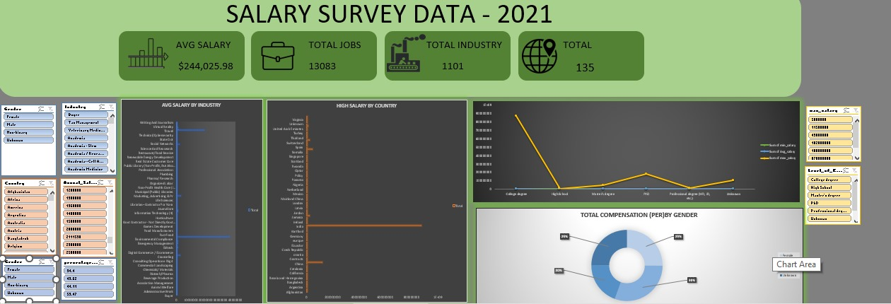
DASHBOARD
The dashboard provides a visual summary of the salary survey analysis.

Slide 10

CONCLUSION
Salaries are influenced by industry, education level, experience, gender, and location.
Higher education and more years of experience usually result in better pay.
Top-paying roles differ across countries and industries.
Gender pay gaps are present in some sectors, though the size of the gap varies.
Certain cities and industries consistently offer above-average salaries.

Slide 11
THANK YOU

